Slide 1
Unit 1. MY HOBBIES
Lesson 6: Skills 2

Slide 2
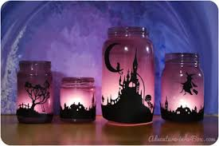
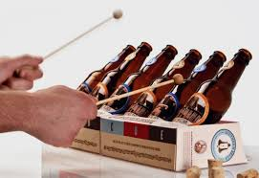
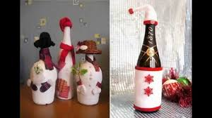
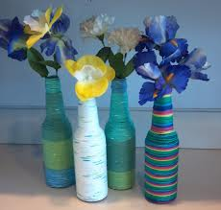
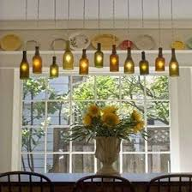
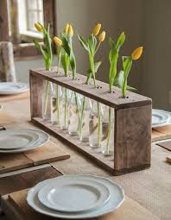
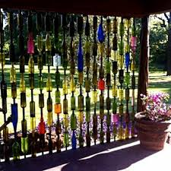
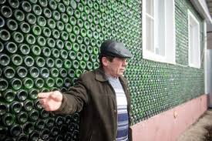
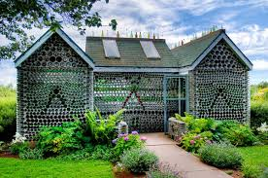
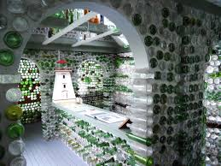
1/ Do you know anything about collecting glass bottles ?
Do you think it is a good hobby ? Why / Why not ?

Slide 3
Ex1: Do you know anything about collecting glass bottles? Do you think it is a good hobby ? Why/Why not?
Yes, I do. I think it is a good bobby. Because after use glass bottles, you can reuse them to make anything! And you are greener.

Slide 4
Ex2: Listen to an interview about hobbies. A 4!Teen reporter, Ngoc asks Mi about her hobby. Complete each blank in the word web with no more than 3 words .

Slide 5
Complete each blank in the word web with no more than 3 words
2. Started:
........
2 years ago.
3.Person who shares the hobby with Mi:
.....................
Name of the hobby:
.....................
collecting
her mother
Mi’s hobby
6. Future: will
...........................
4. To do this hobby Mi has to:
a, collect bottles after use + get them from
...............
b, make ............. vases or
.........
c, use them as ............ Decorations.
continue the hobby
5. Feelings about the hobby;
................
grandmother
flower
lamps
useful
home

Slide 6
Writing:
2. When he/she started the hobby:
Name of the hobby:
3. Who shares the hobby with .......
.........’s hobby
6. Future: will .......
4. To do this hobby you have to............................
5. Feelings about the hobby;..............
4/ Now, write a paragraph about your classmate’s hobby. Use the notes from 3. Start your paragraph as shown below.
__________ is my classmate. His / Her hobby is _______________

Slide 7
Homework
Do exercises E1,2 Page 9 (Workbook)
Prepare next lesson.
Unit 1: Looking back & Project.

